Slide 1
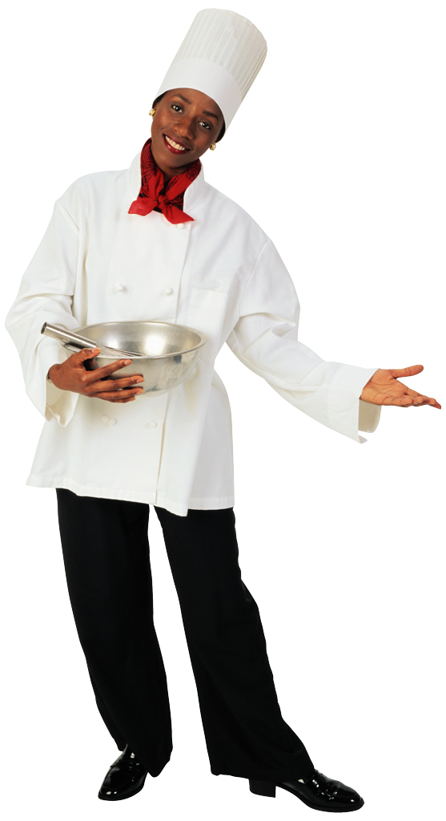
Do now:
Rewrite the following statement in language you would use at a fancy restaurant:
Example:
“Man, this shrimp nasty!”
might become:
“I don’t prefer the shrimp.”
“I can have some chicken?”

Slide 2
Objectives:
SWBAT explain the usefulness of code-switching
SWBAT explain the purpose of speaking in formal (or “standard”) English at school

Slide 3
Picnic vs. Fancy Restaurant
*Turn and talk: Why did we have your brainstorm these lists? How does it connect to formal and informal language?

Slide 4
Informal vs. Formal Language
Notes:
Students and teacher work together to brainstorm examples and situations

Slide 5
Why do it matter? Why does it matter?
“Language of Opportunity”
Job interviews
College
Daily work at your job
Formal writing
PRACTICE is key to fluency.
Notes:
It’s not fair, but it’s an unfortunate truth that in our world, people are judged by how they talk. There are many people who won’t think you are as intelligent as you really are unless you’re expressing your ideas in formal language.
Speaking in formal language makes it easier to write in formal language. It’s a habit that will help you be perceived well. You are all brilliant scholars. More people will recognize that when they see you can speak in the code of Standard English.

Slide 6
What it might look/sound like at Dibert:
A teacher says something like “Time and place” or “Let me hear that in a college-ready sentence.”
A teacher asks you to say an answer again
A teacher repeats your answer back to you in a questioning voice, “They don’t listen to they mama?” (They want you to say it in standard English.)
A teacher circles an answer on your work and asks you to rewrite it in formal/standard English

Slide 7
What is the goal of insisting scholars speak and write in formal English?
It is NOT to embarrass you.
It is NOT because the way we may speak with our families and friends is wrong.
It IS ONLY because the more “codes” you know, the more open the world is to you, the more successful you can be.
Notes:
So many opportunities! My anecdote from Spain and France: I can speak those languages, so while visiting by myself, I was able to chat with people in restaurants and at parks, to understand jokes and have coffee with people from those countries. When I visited with my mom and sister who only speak English, they sometimes felt lonely or frustrated because there weren’t as many people they could talk to.
This is the same thing for codes in English.
It is such a powerful thing to be able to go into a neighborhood and speak with the people there, and really understand them, and also be able to go later into City Hall, and express the needs or wants of that neighborhood in a way that earns you immediate respect. In a way that people in power will listen to.

Slide 8
Exit Ticket:
Answer the following questions in complete sentences:
What are two ways a teacher might remind you to use formal language?
Why do we do our best to speak in Standard English at school and work?

